Slide 1
Week-1 FILE ORGANISATION

Slide 2
What is file organisation?
A file organisation refers to the organisation of the data of a file into records, blocks, and access structures; this includes the way records and blocks are placed on the storage medium and interlinked .

Slide 3
Records
The data stored on disk is organised as files of records.
Records should be stored on disk in a manner that makes it possible to locate them efficiently when they are needed.
Data is usually stored in the form of records.
Records usually describe entities and their attributes.

Slide 4
For example, an EMPLOYEE record represents an employee entity, and each field value in the record specifies some attribute of that employee, such as Name, Birth_date, Salary, or Supervisor.
A collection of field names and their corresponding data types constitutes a record type or record format definition.

Slide 5
Records
Fixed and variable length records
Records contain fields which have values of a particular type
E.g., amount, date, time, age
Fields themselves may be fixed length or variable length
Variable length fields can be mixed into one record:
Separator characters or length fields are needed so that the record can be “parsed.”

Slide 6
Records
The data type of a field is usually one of the standard data types used in programming.
These include : Numeric String of characters Boolean
Sometimes specially coded date and time data types.

Slide 7
Blocking
A Block is the unit of data transfer between disk and memory.
Blocking:
Refers to storing a number of records in one block on the disk.
Blocking factor (bfr) refers to the number of records per block.
There may be empty space in a block if an integral number of records do not fit in one block.
To utilize this unused space, we can store part of a record on one block and the rest on another

Slide 8
Blocking
A pointer at the end of the first block points to the block containing the remainder of the record in case it is not the next consecutive block on disk.
This organisation is called spanned.
If records are not allowed to cross block boundaries, the organization is called unspanned. Spanned Records: - Refers to records that exceed the size of one or more blocks and hence span a number of blocks.

Slide 9
Files of Records
A file is a sequence of records, where each record is a collection of data values (or data items).
A file descriptor (or file header) includes information that describes the file, such as the field names and their data types, and the addresses of the file blocks on disk.
Records are stored on disk blocks.
The blocking factor bfr for a file is the (average) number of file records stored in a disk block.
A file can have fixed-length records or variable-length records.

Slide 10
Files of Records (contd.)
The physical disk blocks that are allocated to hold the records of a file can be contiguous, linked, or indexed.
In a file of fixed-length records, all records have the same format. Usually, unspanned blocking is used with such files.
Files of variable-length records require additional information to be stored in each record, such as separator characters and field types.
Usually spanned blocking is used with such files.

Slide 11
Operation on Files
Typical file operations include:
OPEN: Readies the file for access, and associates a pointer that will refer to a current file record at each point in time.
FIND: Searches for the first file record that satisfies a certain condition, and makes it the current file record.
FINDNEXT: Searches for the next file record (from the current record) that satisfies a certain condition, and makes it the current file record.
READ: Reads the current file record into a program variable.
INSERT: Inserts a new record into the file & makes it the current file record.
DELETE: Removes the current file record from the file, usually by marking the record to indicate that it is no longer valid.
MODIFY: Changes the values of some fields of the current file record.
CLOSE: Terminates access to the file.

Slide 12
Unordered Files
Also called a heap or a pile file.
New records are inserted at the end of the file.
A linear search through the file records is necessary to search for a record.
This requires reading and searching half the file blocks on the average, and is hence quite expensive.
Record insertion is quite efficient.
Reading the records in order of a particular field requires sorting the file records.

Slide 13
Ordered Files
Also called a sequential file.
File records are kept sorted by the values of an ordering field.
Insertion is expensive: records must be inserted in the correct order.
It is common to keep a separate unordered overflow (or transaction) file for new records to improve insertion efficiency; this is periodically merged with the main ordered file.
A binary search can be used to search for a record on its ordering field value.
This requires reading and searching log₂ of the file blocks on the average, an improvement over linear search.
Reading the records in order of the ordering field is quite efficient.

Slide 14
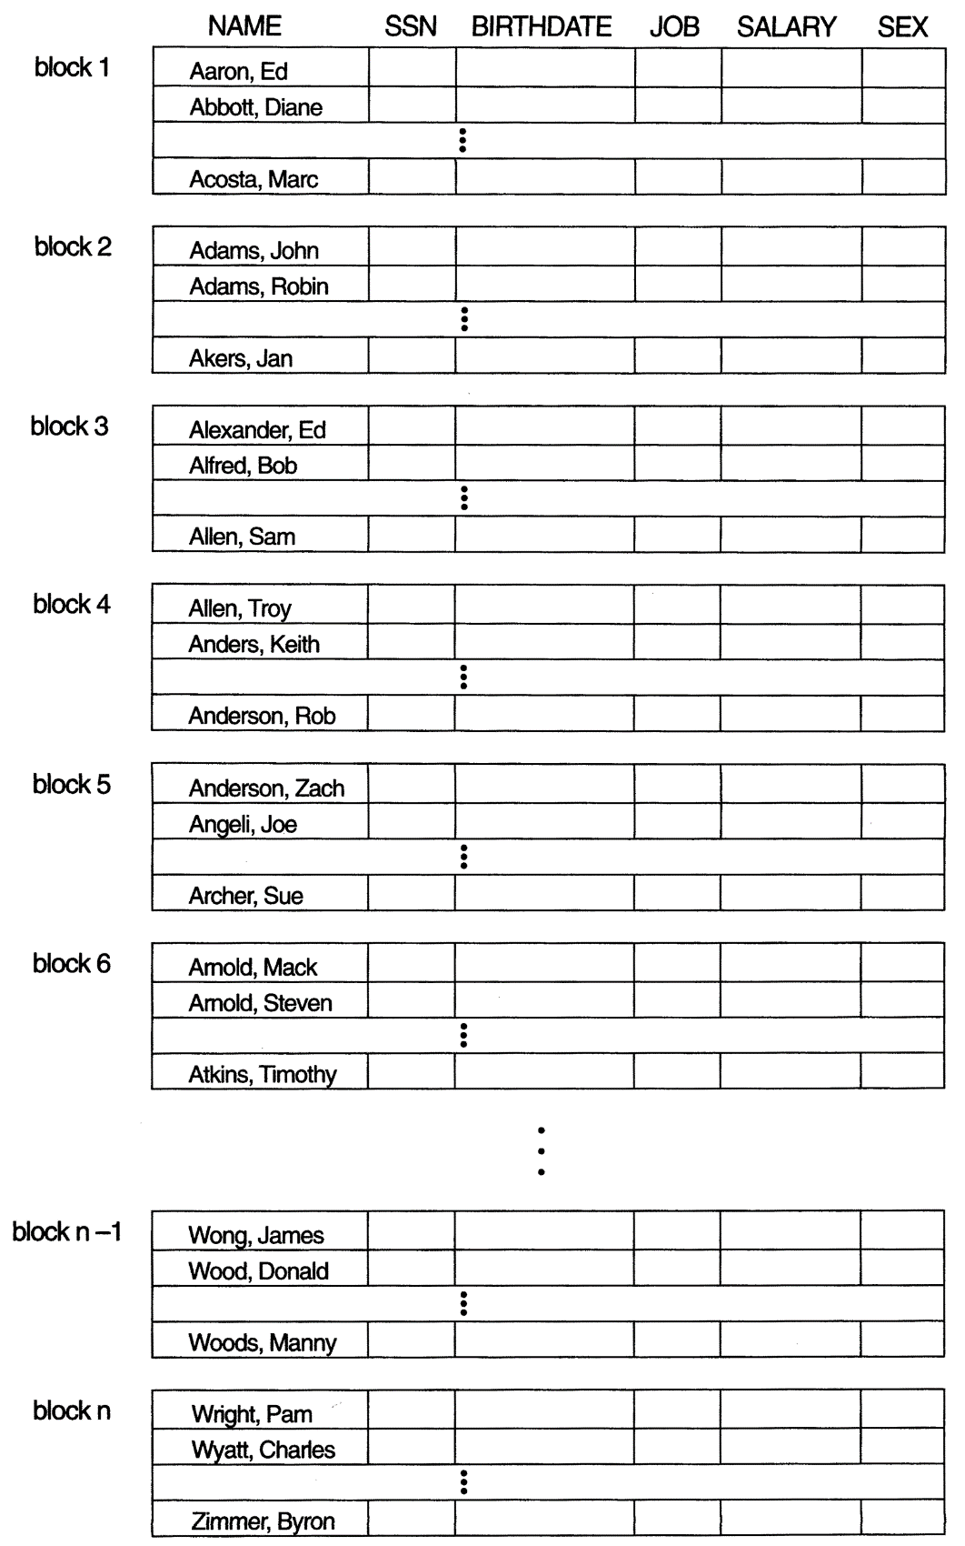
Ordered Files

Slide 15
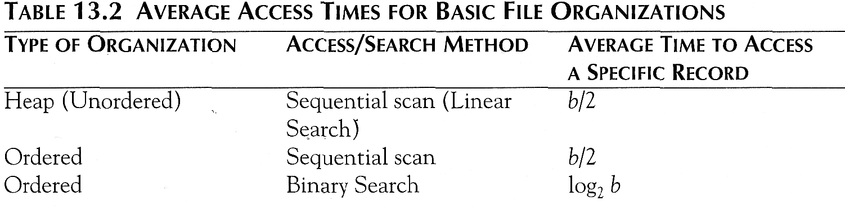
Average Access Times
Table below shows the average access time in block accesses to find a specific record in a file with b blocks.

Slide 16
Hashed Files
A primary file organisation can be based on hashing, which provides very fast access to records under certain search conditions. This organization is usually called a hash file.

Slide 17
External Hashing
Hashing for disk files is called External Hashing
The file blocks are divided into M equal-sized buckets, numbered bucket₀, bucket₁, ..., bucket_{M-1}.
Typically, a bucket corresponds to one (or a fixed number of) disk block.
One of the file fields is designated to be the hash key of the file.
The record with hash key value K is stored in bucket i, where i=h(K), and h is the hashing function.
Search is very efficient on the hash key.
Collisions occur when a new record hashes to a bucket that is already full.
An overflow file is kept for storing such records.
Overflow records that hash to each bucket can be linked together.

Slide 18
Hashed Files (contd.)
The problem with most hashing functions is that they do not guarantee that distinct values will hash to distinct addresses, because the hash field space—the number of possible values a hash field can take—is usually much larger than the address space—the number of available addresses for records. The hashing function maps the hash field space to the address space.
A collision occurs when the hash field value of a record that is being inserted hashes to an address that already contains a different record. In this situation, we must insert the new record in some other position, since its hash address is occupied. The process of finding another position is called collision resolution.

Slide 19
There are numerous methods for collision resolution, including the following:
Open addressing. Proceeding from the occupied position specified by the hash address, the program checks the subsequent positions in order until an unused (empty) position is found.
Chaining. For this method, various overflow locations are kept, usually by extending the array with a number of overflow positions. Additionally, a pointer field is added to each record location. A collision is resolved by placing the new record in an unused overflow location and setting the pointer of the occupied hash address location to the address of that overflow location. A linked list of overflow records for each hash address is thus maintained.
Multiple hashing: The program applies a second hash function if the first results in a collision. If another collision results, the program uses open addressing or applies a third hash function and then uses open addressing if necessary.

Slide 20
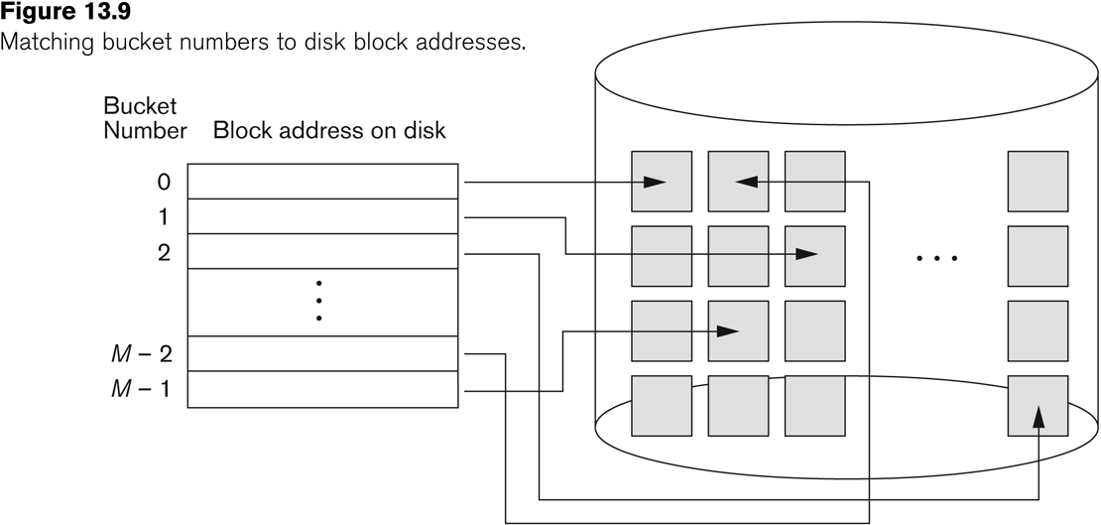
Hashed Files (contd.)

Slide 21
Hashed Files (contd.)
To reduce overflow records, a hash file is typically kept 70-80% full.
The hash function h should distribute the records uniformly among the buckets
Otherwise, search time will be increased because many overflow records will exist.
Main disadvantages of static external hashing:
Fixed number of buckets M is a problem if the number of records in the file grows or shrinks.
Ordered access on the hash key is quite inefficient (requires sorting the records).

Slide 22
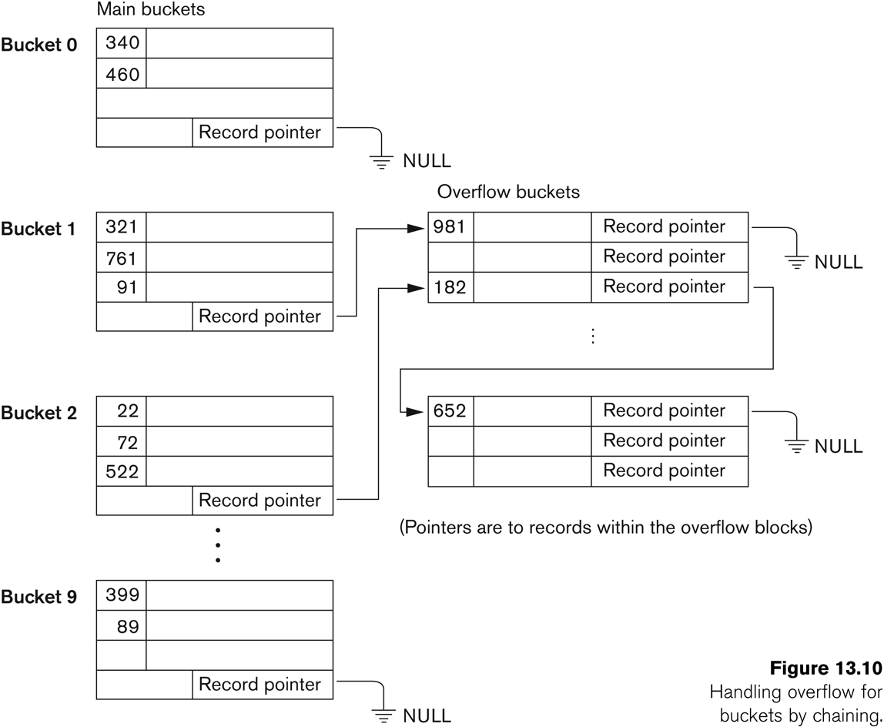
Hashed Files - Overflow handling

Slide 23
Dynamic And Extendible Hashed Files
Dynamic and Extendible Hashing Techniques
Hashing techniques are adapted to allow the dynamic growth and shrinking of the number of file records.
These techniques include the following: dynamic hashing, extendible hashing, and linear hashing.
Both dynamic and extendible hashing use the binary representation of the hash value h(K) in order to access a directory.
In dynamic hashing the directory is a binary tree.
In extendible hashing the directory is an array of size 2^{d} where d is called the global depth.

Slide 24
Dynamic And Extendible Hashing (contd.)
The directories can be stored on disk, and they expand or shrink dynamically.
Directory entries point to the disk blocks that contain the stored records.
An insertion in a disk block that is full causes the block to split into two blocks and the records are redistributed among the two blocks.
The directory is updated appropriately.
Dynamic and extendible hashing do not require an overflow area.
Linear hashing does require an overflow area but does not use a directory.
Blocks are split in linear order as the file expands.

Slide 25
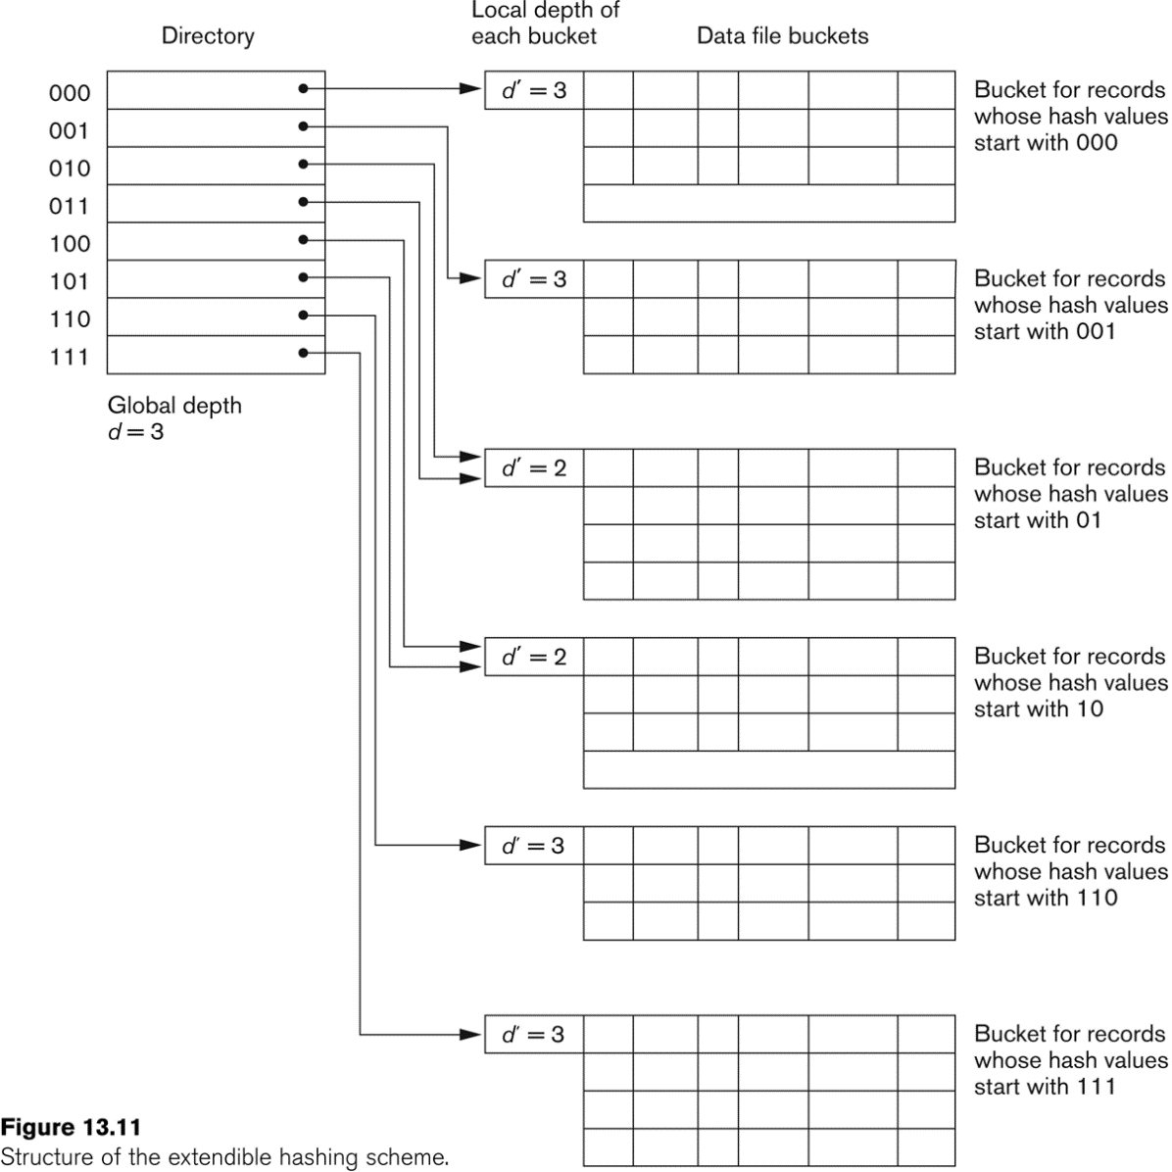
Extendible Hashing

